Slide 1


TP003 - C500 SQL and Python for Production Support
Python endpoints + Docker + Jenkins + Kubernetes + Grafana
GROUP 5
Giovanni De Franceschi
Priya Narayanan
Swapna Menon
Batuhan Cosar
Notes:
Batuhan

Slide 2

Assignment Objectives
Create and launch python API
Add endpoints:
Check password strength
List available currencies
Get list of cryptocurrencies
Get price of crypto
Implement the pipeline to CI/CD
Notes:
Swapna
Financial advisors

Slide 3

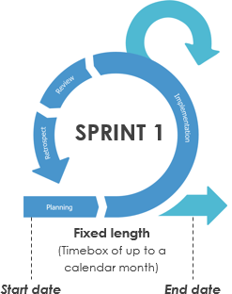
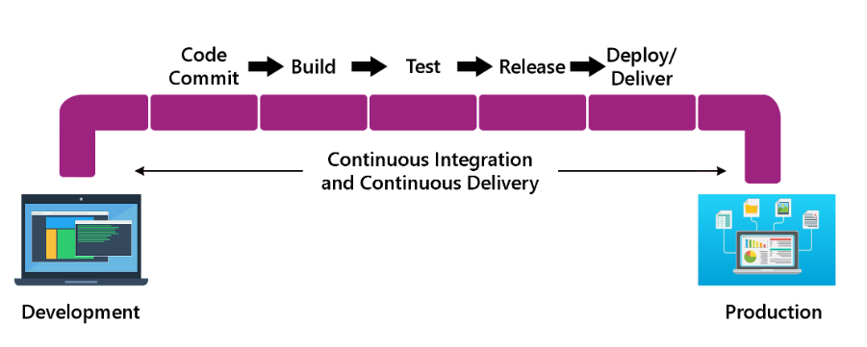
Agile development - CI / CD
PIPELINE
Code automatically integrated and deployed if automated tests pass
Iterations
In contrast to waterfall method
Notes:
Today, software development has shifted from one-time delivery (waterfall) to the Agile methodology, which is based on delivering small amounts of work in a short time to gather feedback. To do that it’s necessary to use a PIPELINE automate build, test integration and delivery of code to be able to do if safely and fast.

Slide 4





Pipeline
pss repo
sre repo
Containerization
Monitoring changes
Manage containers
DEV
Notes:
In this slide we can observe the schema of our software dev pipeline.
Starting from the bottom left, there is an icon representing the Python coding process. The code has been pushed to a GitHub repository. Jenkins has been utilized to automate the creation of Docker containers and their delivery to Amazon. We employed Flux to monitor changes in our containers and notify Kubernetes, which aids in their management

Slide 5
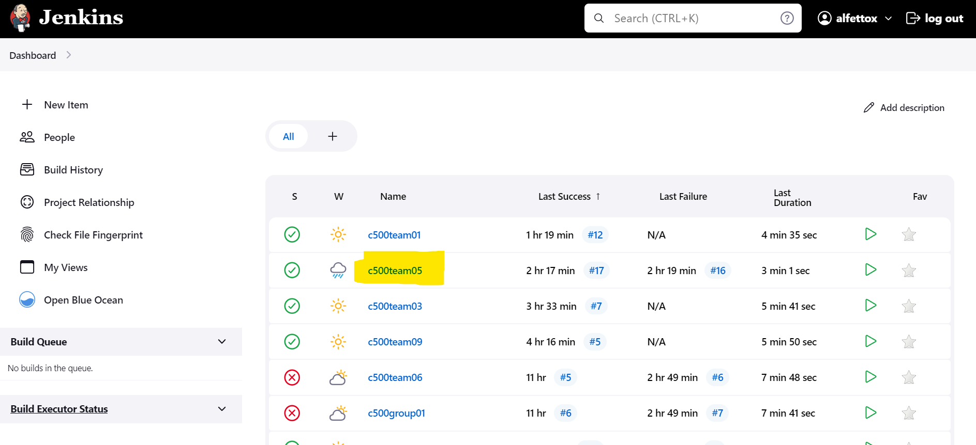
Jenkins
Jenkins automates the building, testing, and deployment of code changes making it more efficient for teams streamline their development workflows.
Notes:
Jenkins - Priya

Slide 6
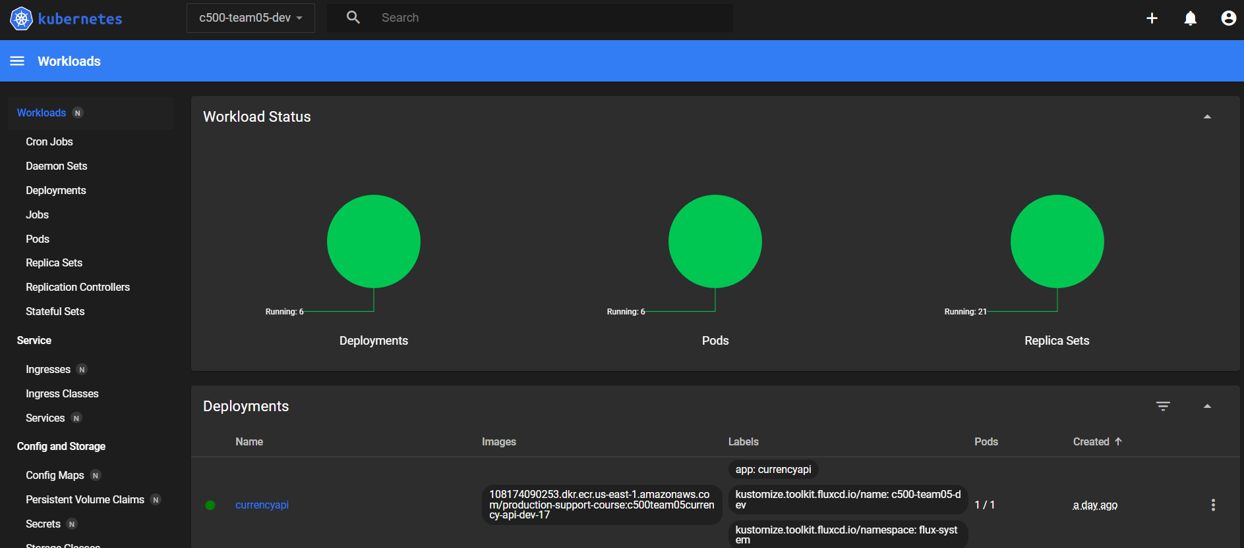
Kubernetes
Automates the deployment, scaling, and management of containerized applications
Provides tools for efficiently managing complex, distributed application environments.
Notes:
Kubernetes - Batuhan

Slide 7
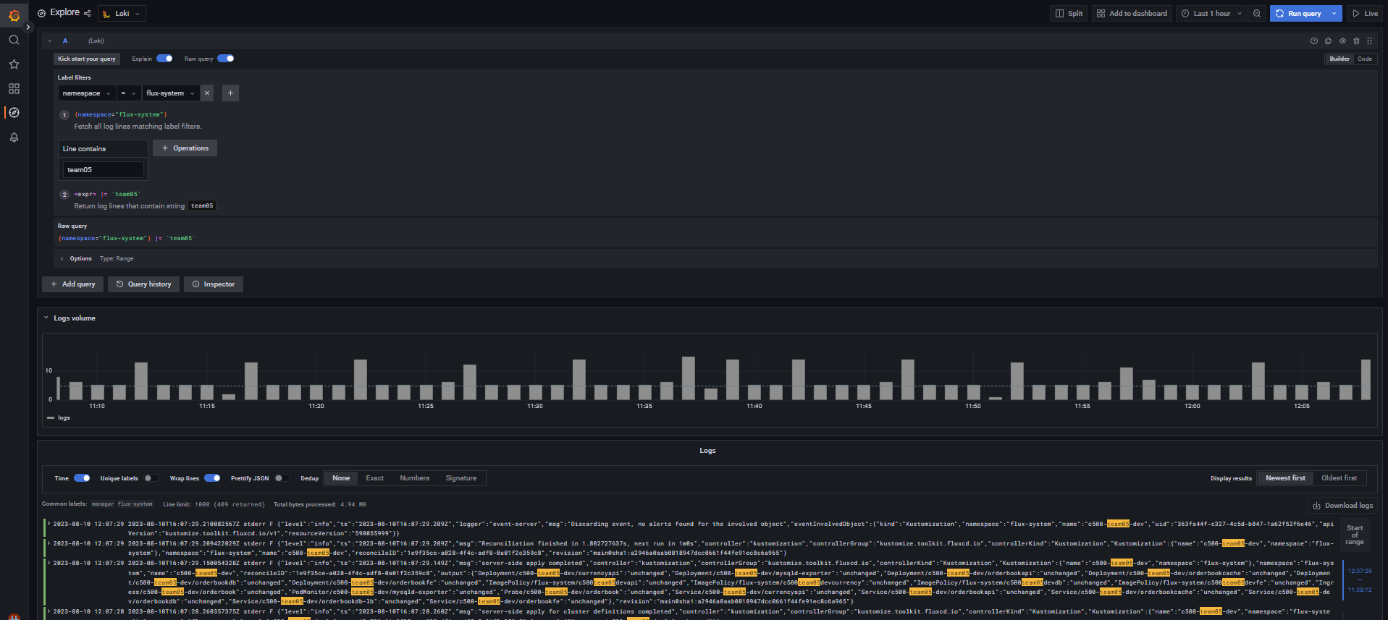
Grafana
Allows users to create interactive and customizable dashboards to visualize and analyze various data sources, such as time-series metrics, logs, and databases
It's widely used for tracking and understanding the performance and health of systems and applications.
Notes:
Grafana - Swapna

Slide 8
API Endpoints
Notes:
Giovanni Alessio Nicolo

Slide 9

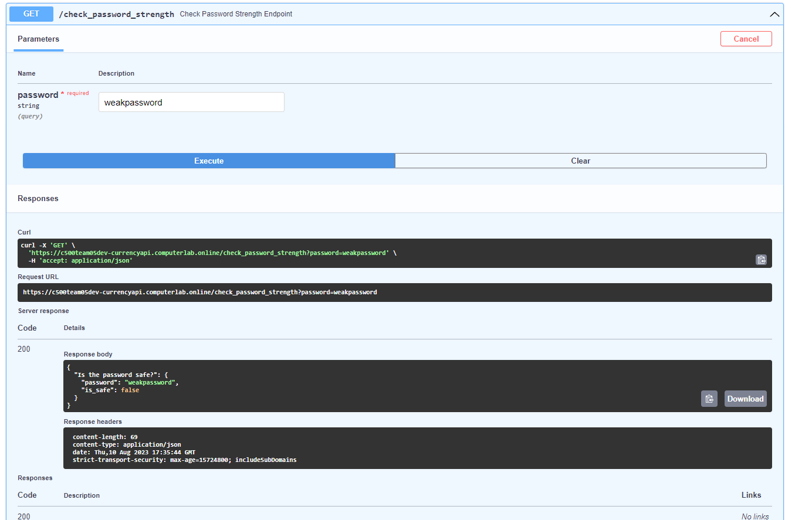

Endpoint 1: Check Password Strength
GET https://c500team05dev-currencyapi.computerlab.online/check_password_strength?password=weakpassword
SEND GET REQUEST
1 query parameter
Conditions:
>= 8 digits/chars
>1 uppercase >1 lowercase
1 number
JSON RESPONSE: True / False
Check Password Strength
Notes:
Giovanni Alessio Nicolo
If the password is secure or not

Slide 10

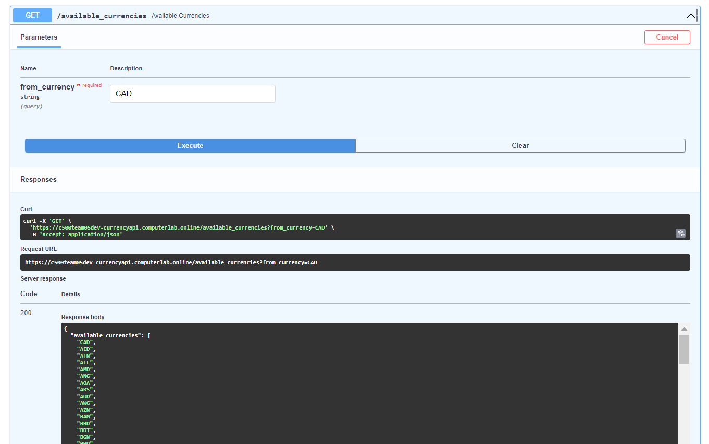
Endpoint 2: List Available Currencies
GET https://c500team05dev-currencyapi.computerlab.online/available_currencies?from_currency=CAD
SEND GET REQUEST
1 query parameter
List of currencies
List Available Currencies
Notes:
Priya

Slide 11

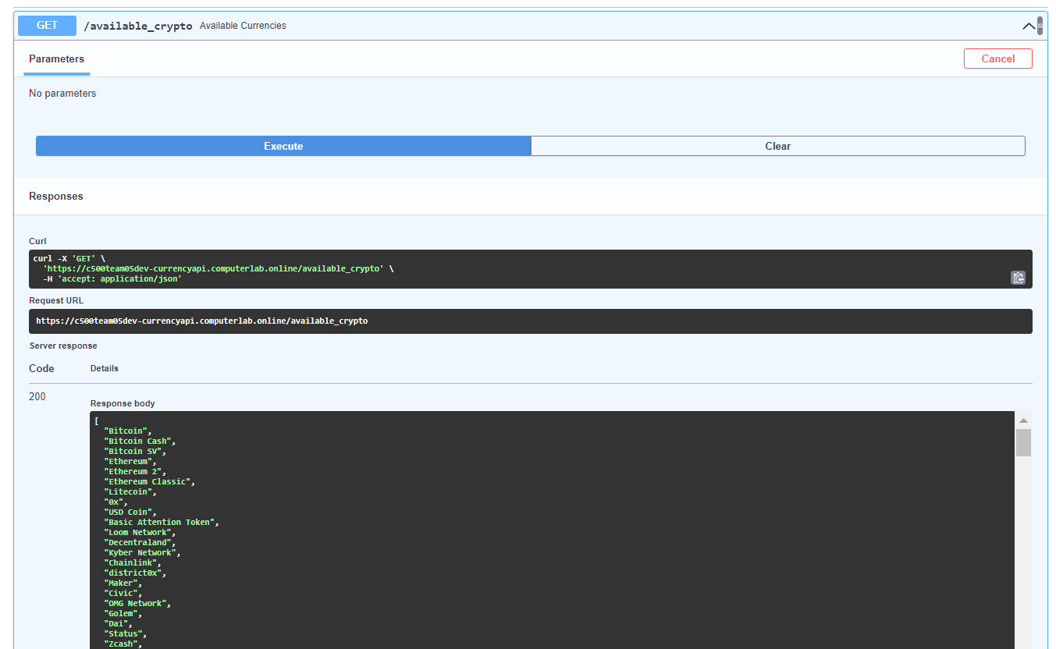
Endpoint 3: List the Cryptocurrencies
GET https://c500team05dev-currencyapi.computerlab.online/available_crypto
SEND GET REQUEST
No parameters
List of cryptocurrencies
List the Cryptocurrencies
Notes:
Batuhan

Slide 12

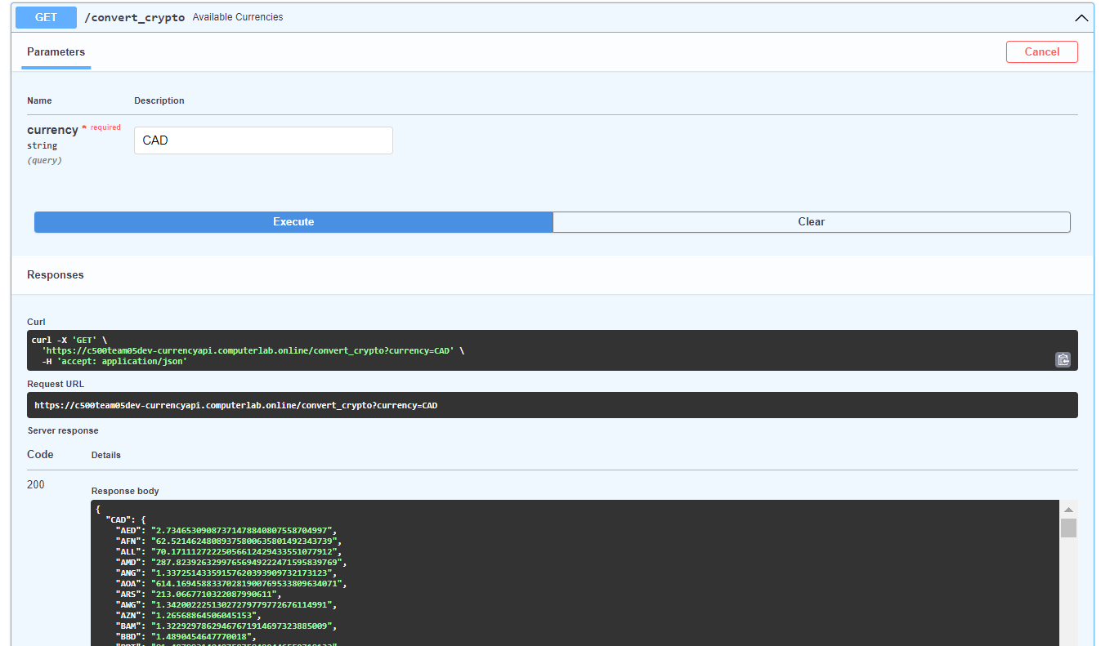
Endpoint 4: Get Price of Cryptocurrencies
https://c500team05dev-currencyapi.computerlab.online/convert_crypto?currency=CAD
SEND GET REQUEST
1 query parameter
List the price of Cryptocurrencies
Price of Cryptocurrencies
Notes:
Swapna

Slide 13

Assignment Difficulties
YAML syntax
Endpoint API not working
Installing Flask, Uvicorn
Server not starting
Notes:
Priya

Slide 14

Improvements
Automating our deployment with Jenkins
Have one standardized zip folder for all python extensions
Having access to a list of commands that would help with Python deployment
Commenting code
Explore Sqlalchemy and the database access (if we had more time)
Looking into creating a Jenkins file from scratch
Create a user interface to help make configuration
Add replicas for a more reliable system
Notes:
Improvements Swapna

Slide 15
Conclusion
This course helped us:
Learning advanced SQL queries
Learning about SRE and DevOps practices
Learning about many tools for creating a pipeline (Jenkins, Kubernetes, Grafana, Flux)
Practicing debugging
Organizing teamwork / Splitting task in a team efficiently
Hands on experience
Notes:
Batuhan

Slide 16

Live demo
https://c500team05dev-currencyapi.computerlab.online/docs
Notes:
Giovanni

Slide 17

THE END
Thank you!
Notes:
Giovanni

